Slide 1




GitOps-Driven Platform Engineering:
Mastering Cluster Fleet Management
Michael Fornaro
Staff DevOps Engineer
Olga Mirensky
Lead Platform Engineer
GDG DevFest
Melbourne
2025

Slide 2
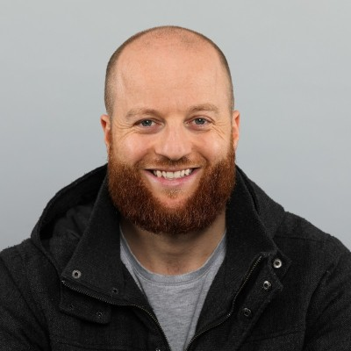
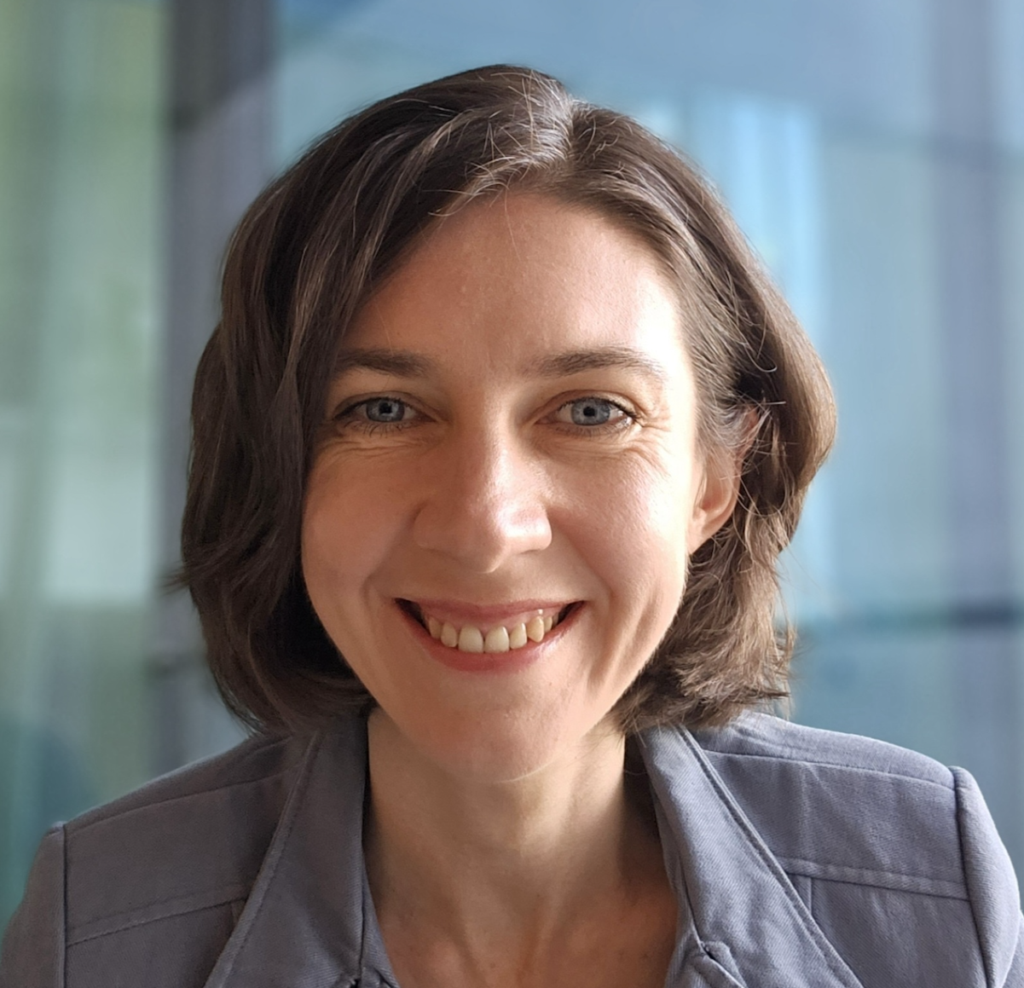
$ WHOAMI
Michael Fornaro
Staff DevOps Engineer
Easygo
Olga Mirensky
Lead Platform Engineer
Macquarie Group

Slide 3
Backstory
Notes:
Speaker: Michael

Slide 4

Stepping back…
Cloud is complicated!
Teams are swamped.
Platforms can help.
Notes:
Speaker: Michael

Slide 5
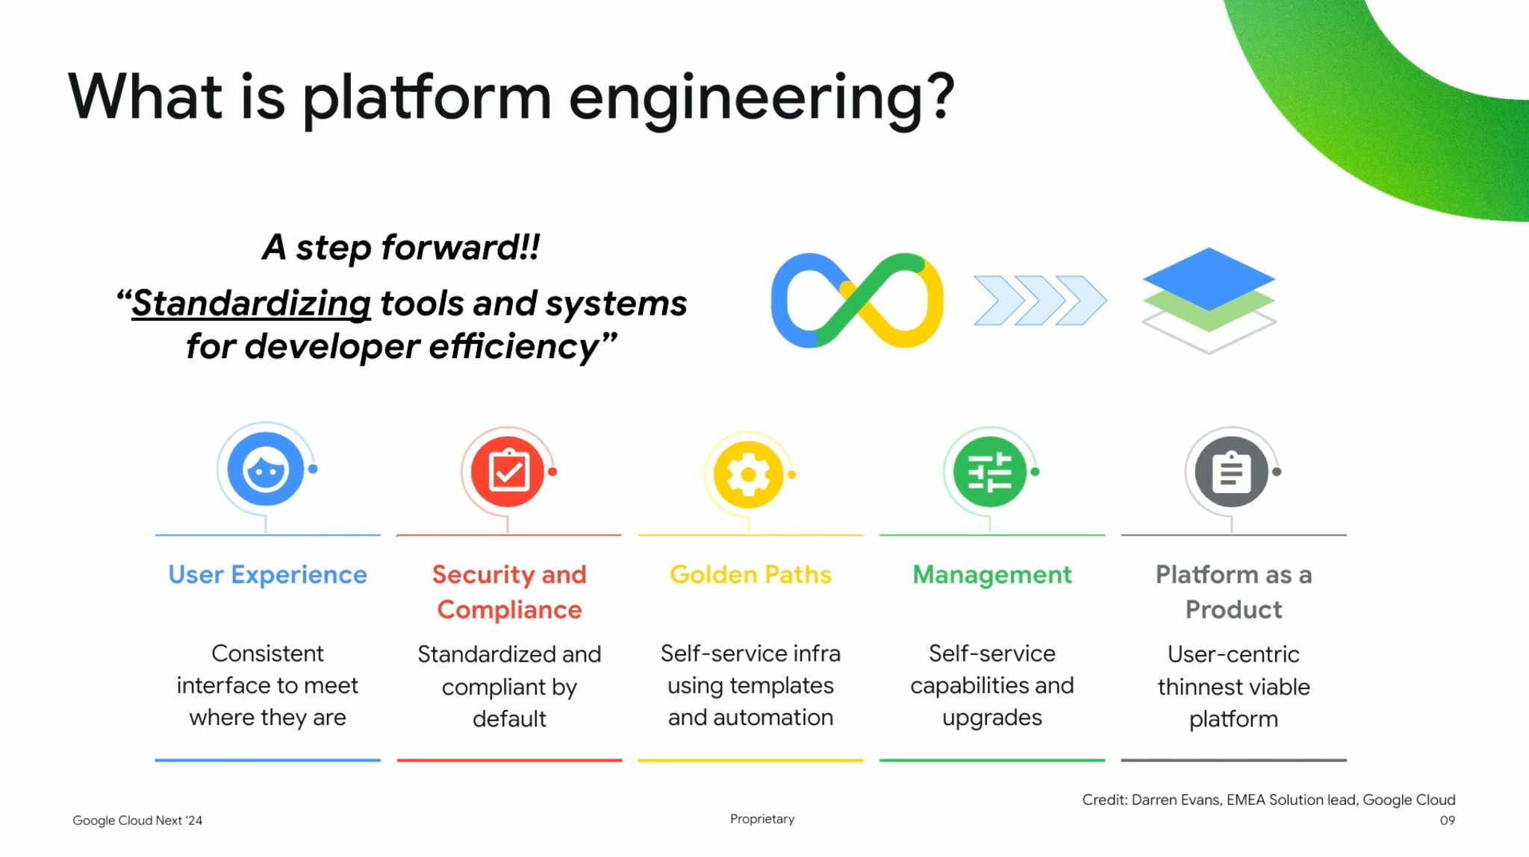
What is Platform Engineering ?!

Slide 6




Platform Engineering
More focus More creativity More agility
Internal
Developer Platform
Google Cloud Resources
CLI / UI / API
Golden Paths
Infrastructure
Dev and Prod
Software Developer
Platform Engineer
Public Cloud
Notes:
Speaker: Michael
Objective: Explain how today's current state of platform engineering still proliferates IDPs and keeps developers close to architectures and infrastructure

Slide 7
Platform Engineering
Internal
Developer Platform
More focus More creativity More agility
Google Cloud Resources
Define Application into archetype
Golden Paths
Infrastructure
Dev and Prod
Software Developer
Platform Engineer
Public Cloud
Notes:
Speaker: Michael
Objective: Introduce archetype word and prepare transition across to Olga

Slide 8
Archetypes Introduction
Notes:
Speaker: Olga
Objective: Introduce and prepare concept of how archetypes determine architecture and that we shouldn’t directly interface developers with architecture decisions

Slide 9
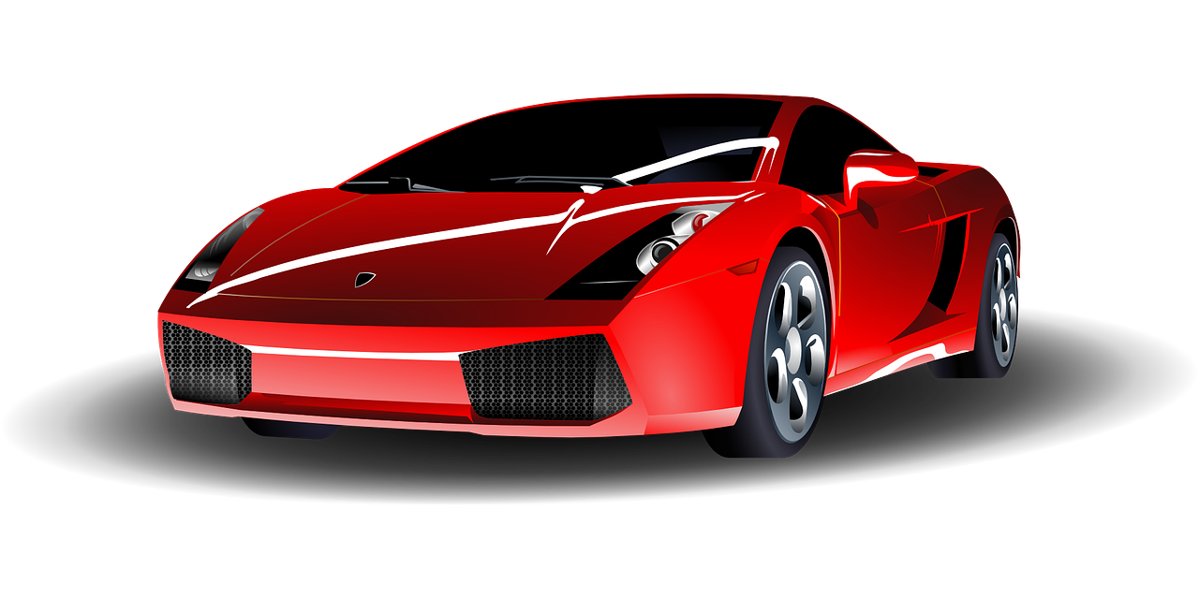
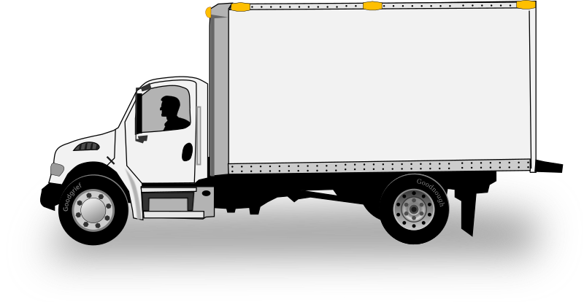
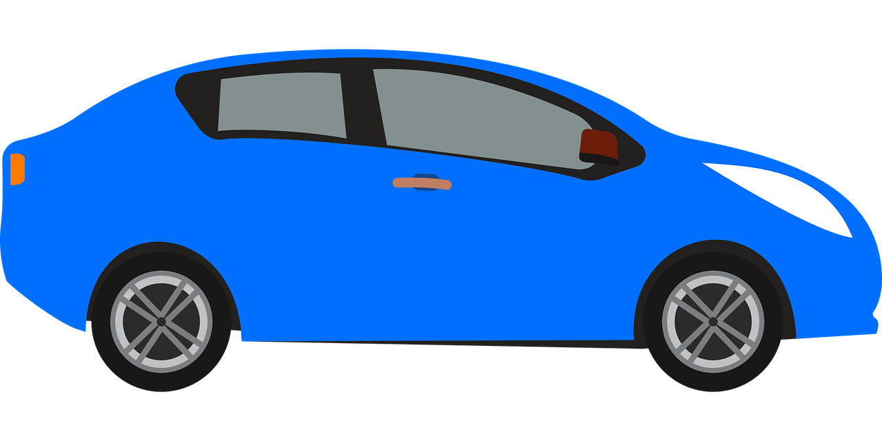
Let's Go: Car Shopping
"I need a new <vehicle>!"
Really:
I want to go fast
I need to carry lots of stuff
I don't want to spend much
Notes:
Speaker: Olga
Objective: Explain how a person buys a car through a car salesman by collecting the right requirements

Slide 10
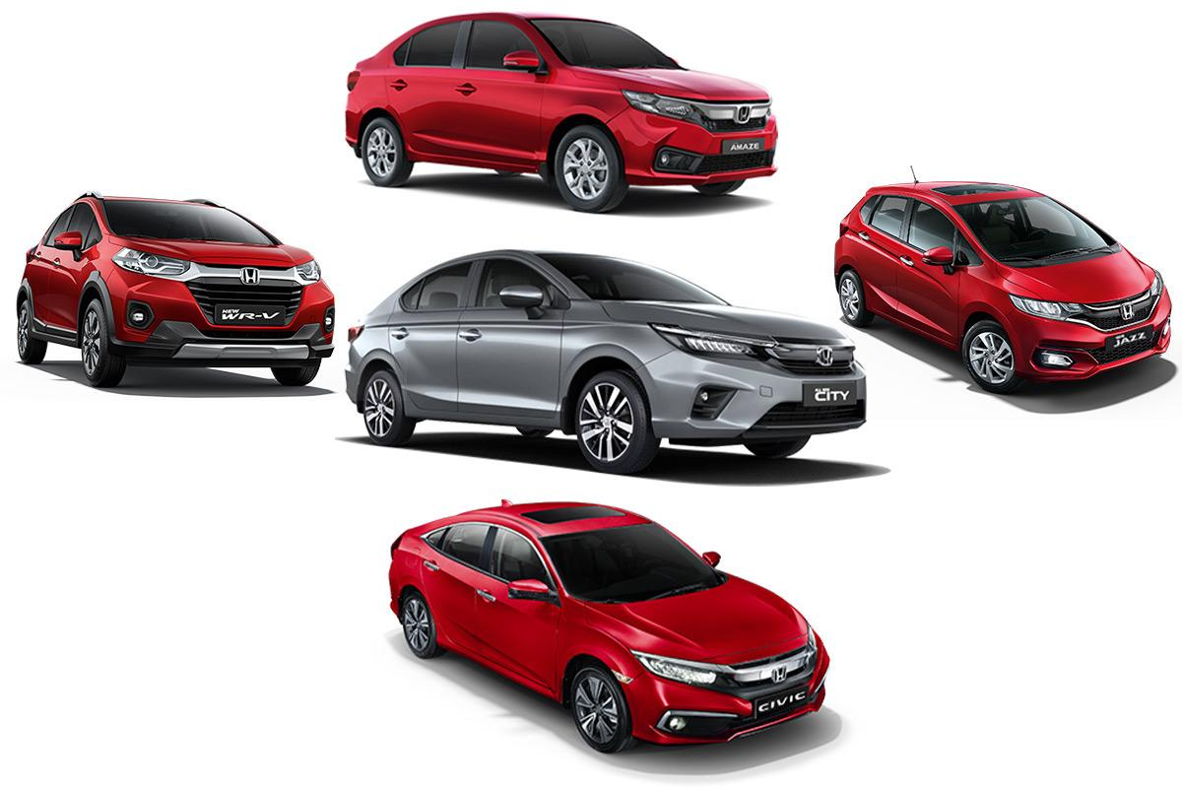
Refinement
Once you pick a type, you can choose a make and model.
Notes:
Speaker: Olga
Objective:

Slide 11
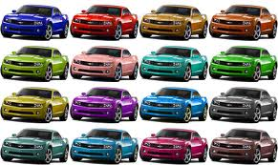
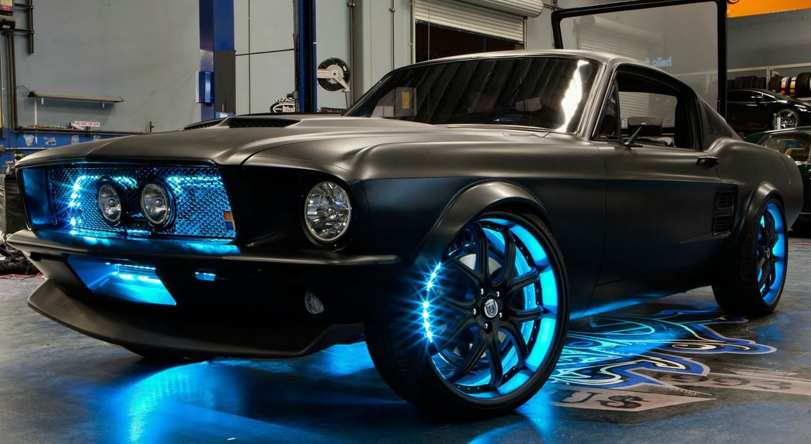
Customization
Then, you choose the one for you.
Maybe you make it even more for you.
Notes:
Speaker: Olga
Objective:

Slide 12
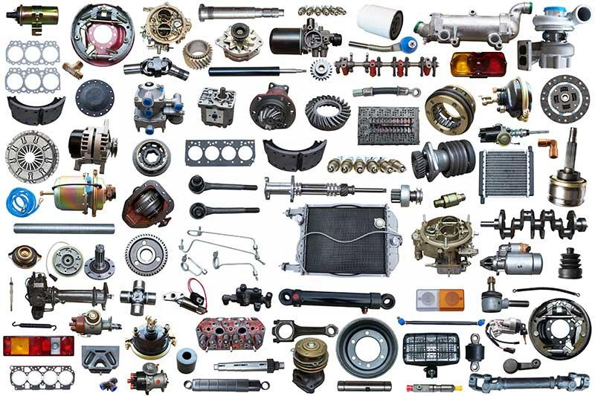

NOT Car Shopping!
Notes:
Speaker: Olga
Objective: The difference between buying a car from a car salesman vs building a car from scratch with a mechanic.

Slide 13
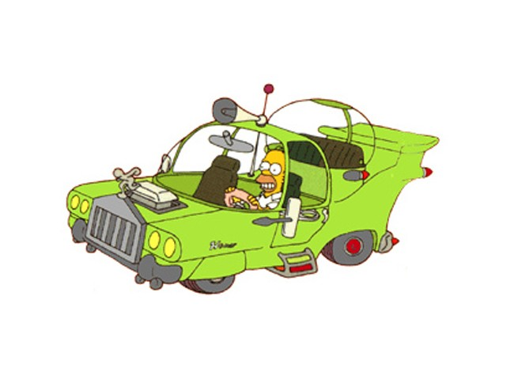
Too Much Choice can be Disastrous
What we think we want
vs
How it actually turns out
https://simpsons.fandom.com/wiki/The_Homer
"the type of car Americans really want, not the kind we tell them they want"
Notes:
Speaker: Olga
Objective:

Slide 14

A deployment archetype is an abstract, provider-independent model that you use as the foundation to build application-specific deployment architectures that meet your business and technical requirements
goo.gle/app-archetypes
Notes:
Speaker: Olga
Objective: focus on APP requirement as main focus.

Slide 15
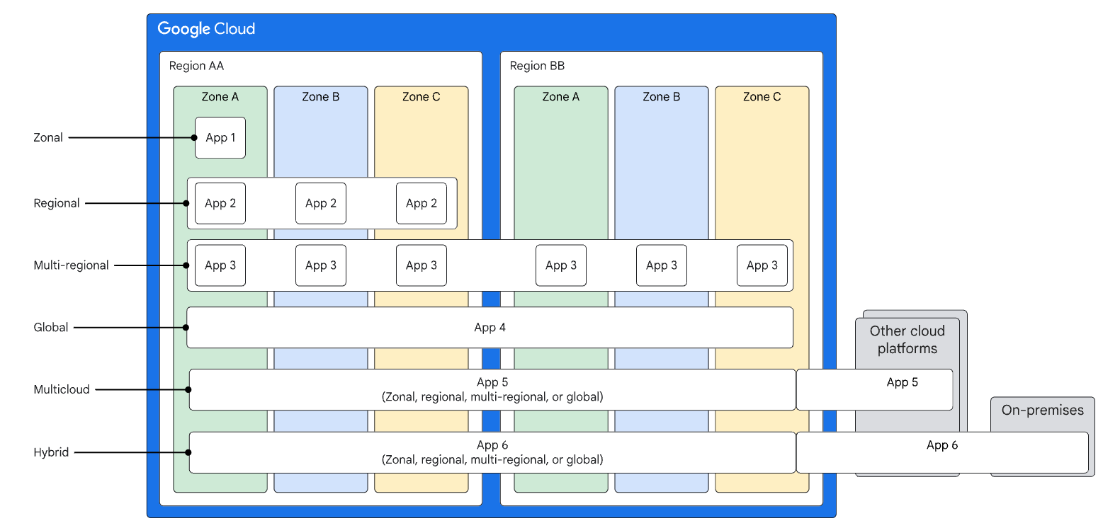
Deployment Archetypes
goo.gle/app-archetypes
Notes:
Speaker: Olga
Objective: combination of failure domains where an application can run

Slide 16
From Abstract Model to Implementation
Notes:
Speaker: Michael

Slide 17
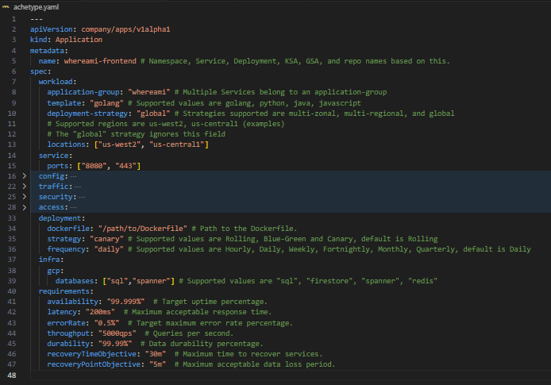
Notes:
Speaker: Michael

Slide 18
effort,
cost
reliability
Notes:
Speaker: Michael
Objective:

Slide 19
How to use Archetypes?
Services can be deployed to a single archetype
Applications can use services across multiple archetypes
Application
Service A
Service A
Service B
Service C
Service D
Notes:
Speaker: Michael
Objective:

Slide 20
How to use Archetypes?
Services can be deployed to a single archetype
Applications can use services across multiple archetypes
Applications should be designed for graceful degradation
Application
Application
Service A
Service A
Service B
Service A
Service B
Service C
Service D
Service C
Service D
Notes:
Speaker: Michael
Objective:

Slide 21










Cloud Failure Domains: Regions, Zones
Clusters, Pods, Apps, Functions, VMs
Products expose their failure domains differently
Region 1
Run
Store / Analyze
Region 1
Cloud Deploy
Cloud Functions
Cloud Spanner
Zone A
Cloud
Run
Cloud SQL
Zone B
GKE
Dataflow
Container Registry
Zone C
Compute Engine
Cloud Storage
Artifactory, npm, Maven, Github
Notes:
Speaker: Michael
Objective:

Slide 22
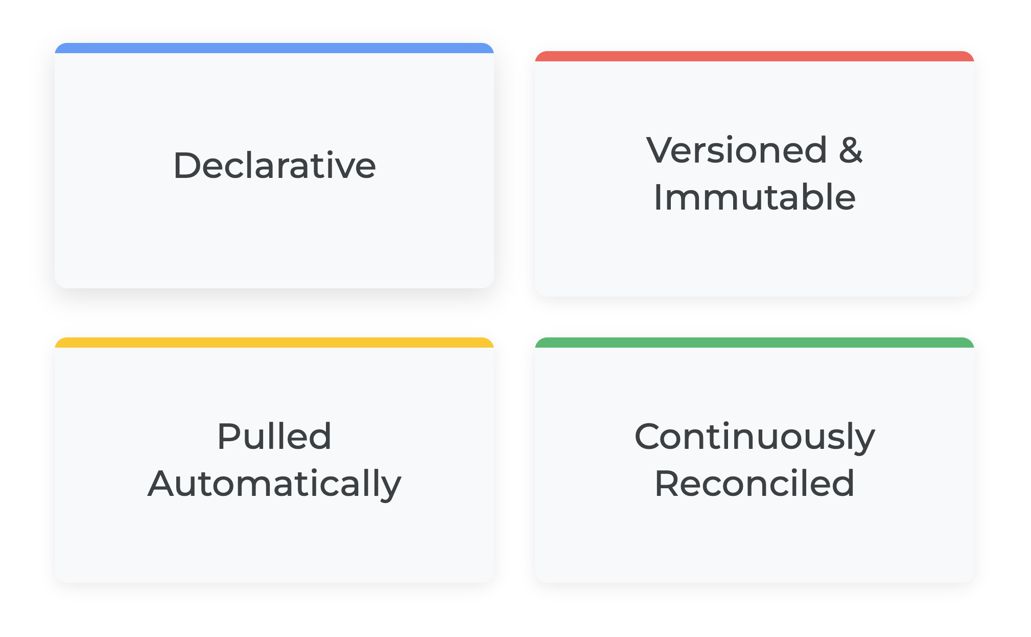
What is GitOps?
https://opengitops.dev/
Notes:
Speaker: Michael

Slide 23
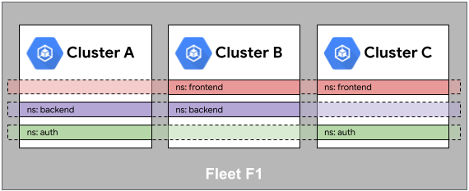
What are Fleets of Clusters?
Namespace sameness in a fleet
Notes:
Speaker: Michael
Objective: Introduce the concept of how we can scale into Fleets, what are Fleets? How should we think of cluster(s) whether 1 or 1000 exist!?

Slide 24
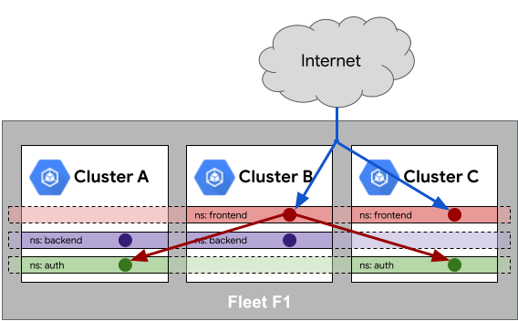
What are Fleets of Clusters?
Service sameness in a fleet
Service sameness in a fleet
Notes:
Title:
Speaker: Michael
Objective: Introduce the concept of how we can scale into Fleets, what are Fleets? How should we think of cluster(s) whether 1 or 1000 exist!?

Slide 25
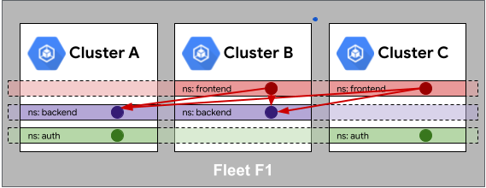
What are Fleets of Clusters?
Identity sameness inside a fleet
Notes:
Title:
Speaker: Michael
Objective: Introduce the concept of how we can scale into Fleets, what are Fleets? How should we think of cluster(s) whether 1 or 1000 exist!?

Slide 26
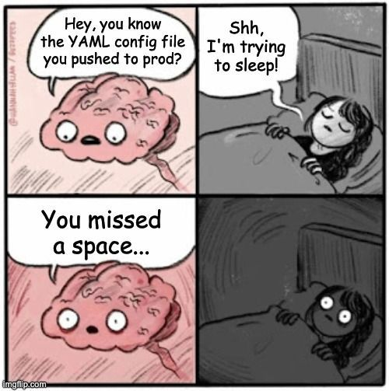
Mastering Cluster Fleet Management
Notes:
Title:
Speaker: Michael
Objective: How can we create ephemeral clusters and infrastructure and federate applications across Fleets with near zero pain

Slide 27
Demo
Notes:
Speaker: Michael
Objective: How can we create ephemeral clusters and infrastructure and federate applications across Fleets with near zero pain

Slide 28
Demo video

Slide 29

Unpacking the Demo - Principles
Platform Engineer
Cookie-cutter reproducible clusters
Clusters on-demand: Testing Environments, Disaster Recovery.
Golden paths and guardrails
Scalable
Application Developer
Infrastructure management decoupled from Application
App placement based on archetype
Scale seamlessly to 5 or 500 clusters
Notes:
Speaker: Olga

Slide 30
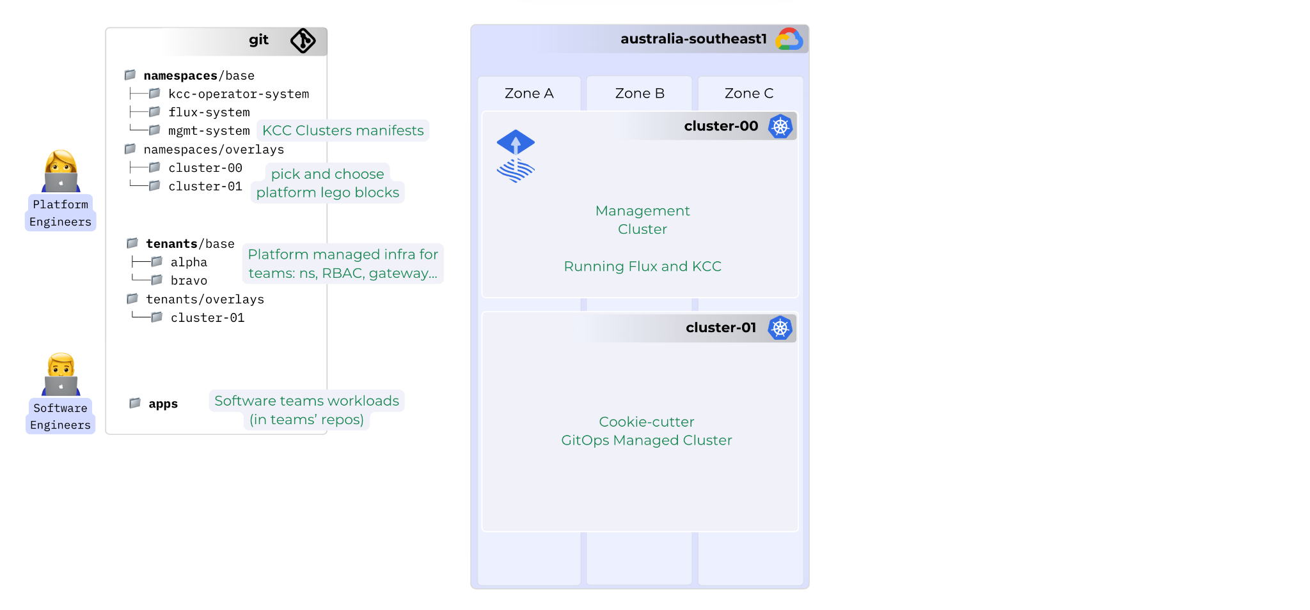
Notes:
Speaker: Olga
Objective: Infra vs Application; base = templates

Slide 31
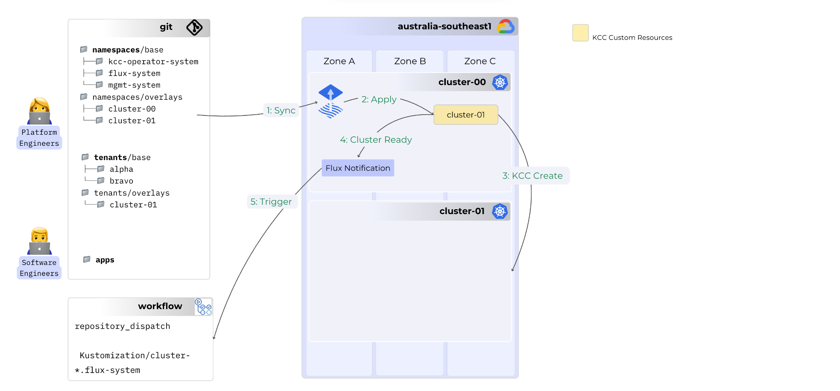

Slide 32
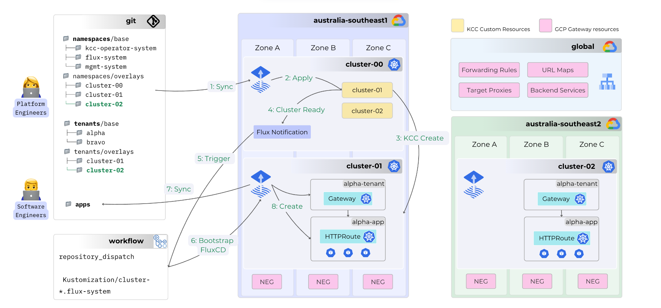

Slide 33


Takeaways
Scale kubernetes configuration
Unlock the power of archetypes
Unlock the power GitOps

Slide 34
Conclusion & Links
https://fluxcd.io/flux/
https://control-plane.io/posts/d2-reference-architecture-guide/
https://rawkode.academy/read/fluxcd-the-inevitable-choice/
https://slsa.dev/spec/v1.2-rc1/use-cases
https://cloud.google.com/architecture/deployment-archetypes
https://opengitops.dev/
https://platformengineering.org/blog/what-is-platform-engineering

Slide 35


Let’s Connect!
linkedin.com/in/olgamirensky/
Easygo Careers
linkedin.com/in/michael-fornaro/

